Slide 1
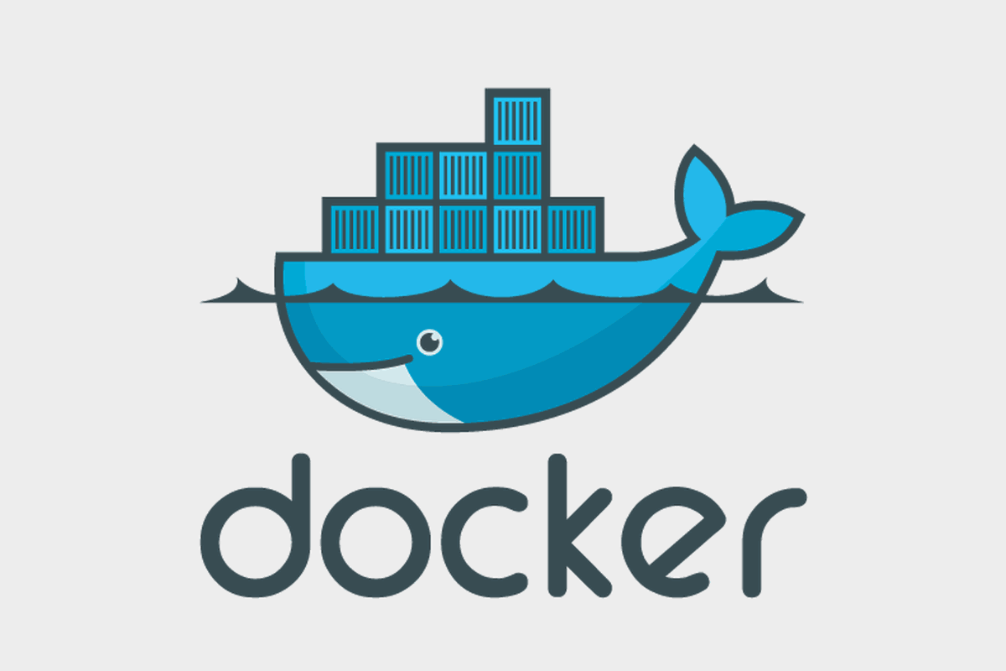
Introduction to Docker

Slide 2
Agenda
What is Docker
Docker vs. Virtual Machines
Images and Containers
Docker hub
Main Commands in Docker

Slide 3
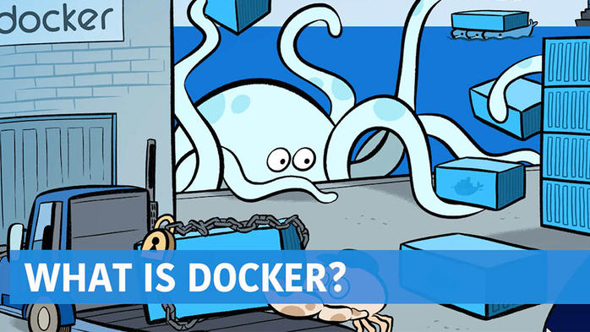
An isolated Operated system
Create, deploy, and run application
Images and Containers

Slide 4
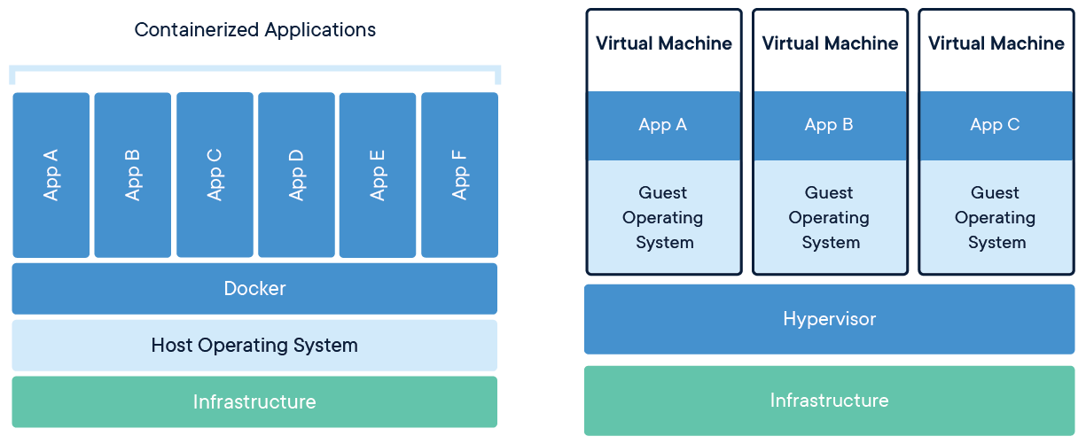
Docker vs. Virtual Machines
Notes:
Virtual Machines
Each virtualized application includes not only the application - which may be only 10s of MB - and the necessary binaries and libraries, but also an entire guest operating system - which may weigh 10s of GB.
Docker
The Docker Engine container comprises just the application and its dependencies. It runs as an isolated process in userspace on the host operating system, sharing the kernel with other containers. Thus, it enjoys the resource isolation and allocation benefits of VMs but is much more portable and efficient.
Docker provides base images that contain OS installations we can start from: The OS is not more than an application running on the Kernel...

Slide 5
Docker Images
A Docker image is a file, comprised of multiple layers which is used to execute code in Docker containers.
List of docker commands related to image:
Docker images – show all images created
Docker run : create a container from image and execute it.
Docker tag: tag an image
Docker pull: download an image from repository
Docker rmi: delete a local image
Notes:
Docker images have layers tthat increase reusability, decrease disk usage and speed up docker build by using cache in each step. These are not showed as default.
For instance, creating multiple images one after another, the cache will be used so the previous built images (or dependencies) will be used to create the new image.
When Running a docker image it initializes an instance of that container.

Slide 6
Docker Containers
A docker container is a runnable instance of an image.
List of docker commands related to containers:
Docker ps : list all running containers
Docker ps -a : list all containers
Docker top: display processes of containers
Docker start: start a stopped container
Docker stop: stop a running container
Docker rm: delete a container
Docker commit: create an image from a container
Docker container update: update configuration of one/more containers
Docker exec: run a command in a running container.
Notes:
Docker images have layers that increase reusability, decrease disk usage and speed up docker build by using cache in each step. These are not showed as default.
For instance, creating multiple images one after another, the cache will be used so the previous built images (or dependencies) will be used to create the new image.
When Running a docker image it initializes an instance of that container.

Slide 7
DockerFile
Create images automatically using a build script <<Dockerfile>>
Docker hub can automatically build images based on dockerfiles on Github.
Commands:
Add - copies a file from host system onto container
CMD/ENTRYPOINT – The command that runs when the container starts
EXPOSE – opens a port for linked containers
FROM – the base image to use in the build and load other images.
RUN – executes a command and save the results
VOLUME – creates a shared volumethat can be shared among containers
WORKDIR – set the default working directory for the container.

Slide 8
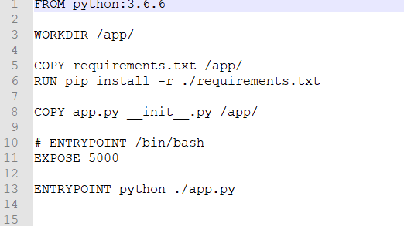
How a dockerfile looks like?

Slide 9
Docker commands Example
Create an image
Docker build . -t “image name:tag”
Docker run –d–p 8080:80 “image filename” – (-d -> detach) (-p map port 80 to host port 8080)
docker exec –it “containers name” bash – to get inside the container
Docker push myrepo/myapp:1.0 – push an image to docker hub
Docker pull imagename – pull from public docker hub or your dockerhub account.
Docker tag “imagename” “myrepo/imagename”.

Slide 10
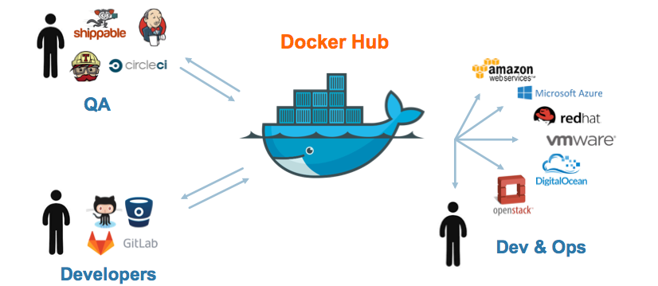
DockerHub

Slide 11
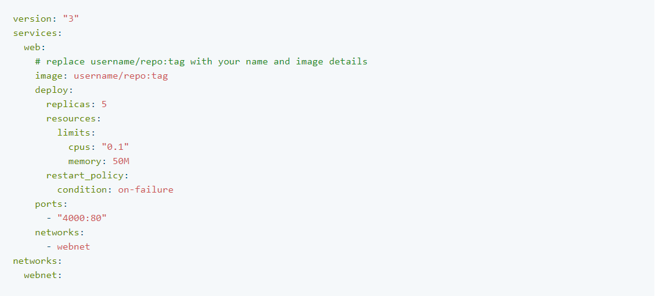
Docker Compose
Compose is a tool for defining and running multi-container Docker applications. With Compose, you use a yaml file to configure your application’s service and with a single command, you create and start all the services from your configuration.
Notes:
Docker-compose.yml -> define the services that make up your app. They can run together in an isolated environment.
Docker –compose up to run and compose starts and runs your entire app.
For instance:
Configure Volumes, Databased, workers, networksetc.

Slide 12
Ali Doku AI Engineer & Data Scientist +32 489 84 28 73 ali.doku@arinti.ai
www.arinti.ai
Veldkant 33a 2550 Kontich
Gaston Geenslaan 11 B4 3000 Heverlee

